Slide 1

VTouch
Virtual Mouse Control using Hand Gestures

Slide 2





CONTENTS OF THE SLIDE
01 Overview
A brief overview of VMouse App. What is motivation behind it and what are objectives for development of this app and What do We Aim to Achieve.
02 Literature Survey
A descriptive information about what and why has been reviewed ,analyzed about sentiment analysis/Negative news detection/ good news classification.
03 Proposed Methodology
This phase includes all the details of the working of app, all the planning phase details and look of the app. All the features app provides to users of the app supposedly. It is all about what we found good so far multiple changes are supposed to be performed for future work.
04 Technology Stack and Requirements
A brief description of all the official tools, sources, all the software and hardware used to develop this app and documentation required for the development of this app.
05 Upcomings
This slide includes the glimpse of what we plan to do for future meetings and what can be expected from us for the same.
06 Conclusion & References
A short summary or conclusion of app. The references which were used to develop the app.

Slide 3

01
Overview Of the Project

Slide 4
Problem Statement
It aims to address the issue of limited accessibility and convenience when using a physical mouse.
For individuals with physical disabilities or those who require hands-free navigation, it could provide a more comfortable and efficient way of interacting with a computer.
The primary goal of this project is to create a user-friendly interface that allows users to control the computer seamlessly and accurately without the need for physical mouse devices.
To design a virtual mouse which detects hand gestures and performs mouse operations only using the fingers.
Easy to use and cost effective.

Slide 5

Motivation & Aim
The conventional method of controlling a computer mouse is by physically moving it on a surface. However, this approach is not always convenient, particularly in situations where desk space is limited or when the user has a physical disability that makes it challenging to use a traditional mouse.
As the COVID-19 pandemic has taught us, reducing physical contact with shared surfaces is critical to maintaining good health. By using hand gestures instead of a traditional mouse, we can reduce the need for physical contact with shared devices.

Slide 6

Objectives
Easier Interaction providing a more intuitive and natural interface for navigating and controlling the computer, without the need for physical devices such as mice or touchpads.
Improved accessibility for individuals with physical disabilities.
Smoother usability for enhancing the overall user experience for all users with easier sets of gestures to use the device.

Slide 7
02
Literature Survey

Slide 8
Literature Survey
Sr. No | Paper | Method | Conclusion
3. | Vicari, M. and Gaspari, M., 2021. Analysis of news sentiments using natural language processing and deep learning. Ai & Society, 36(3), pp.931-937. | Dataset: https://www.kaggle.com/aaron7sun/stocknews/home 2. Data Set Size: 3000 3. Model Applied: NLP + LSTM | 1. Accuracy: 57.94% which is slightly higher than flip of a coin(Non-Considerable). 2. This can be improved by increasing the size of the dataset.
4. | Taj, Soonh; Shaikh, Baby Bakhtawer; Fatemah Meghji, Areej (2019). [IEEE 2019 2nd International Conference on Computing, Mathematics and Engineering Technologies (iCoMET) - Sukkur, Pakistan (2019.1.30-2019.1.31)] Sentiment Analysis of News Articles: A Lexicon based Approach. , (), 1–5. | 1. Polarity Calculation Is performed. 2. Lexicon/Word-Net dictionary for opinion Scores & Total sentiment score. 3. Classification on the basis of -1,0,1(+,n,-) to get the desired results. 4. lexicon/word-based approach. Dataset: BBC News Dataset(Up to 40,897 news articles –Training,2500 for testing). | 1. *Language Issue -only English Based. 2. *Insufficient word coverage- (Database Live Update Issue) 3. Accuracy: up to 91%(when class labels were provided).

Slide 9
Research Gap
Accuracy of Gestures: The accuracy of hand gestures in controlling the virtual mouse is heavily dependent on the user's ability to perform the gestures correctly. If the user makes an incorrect gesture, the virtual mouse may not respond appropriately, leading to frustration and dissatisfaction.
Limited Range of Gestures: The range of hand gestures that can be used to control the virtual mouse may be limited, making it challenging to perform certain tasks. This could result in users reverting to traditional methods of controlling a computer mouse.
Latency in Recognition: The current systems aren’t fast enough to capture the gestures in real time properly.
Fatigue and ergonomics: Repeatedly making hand gestures for extended periods of time can be tiring and can lead to muscle fatigue and strain.
Standardization of gesture sets: Currently, there is no standard set of hand gestures that are universally recognized by all users. Different applications and systems use different sets of gestures, which can lead to confusion and inconsistency.

Slide 10
03
Proposed Methodology

Slide 11
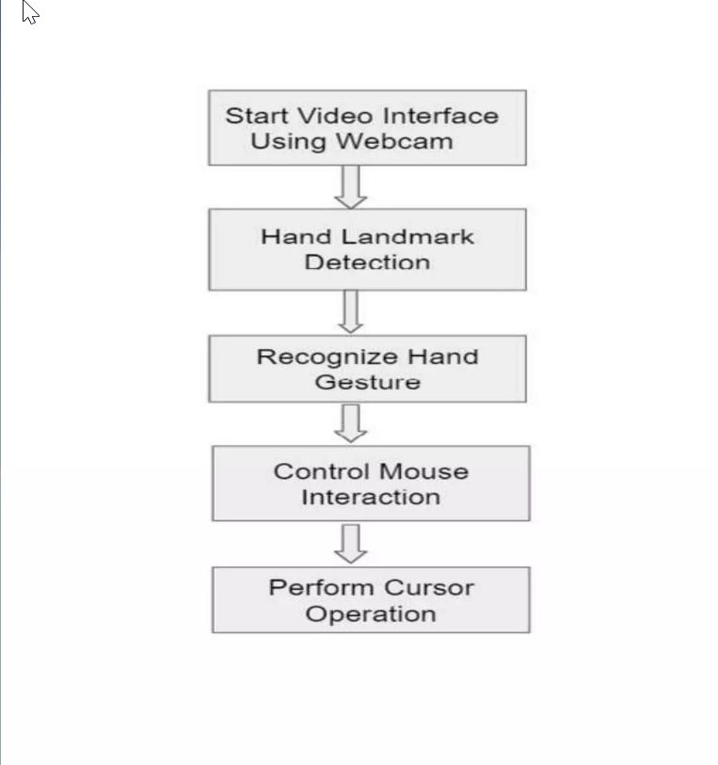
Proposed Method
In Proposed system users don't have to color their fingers with a specific color and are not required to use any other expensive device, mouse or sensors.
Systems Already existing are not as smooth and fast.
I would be using mediapipe with CNN for smoother recognition and working.
The Operations wouldn’t be just limited to basic left click, right click and double click features. Operations that I intend to implement are: Left, Right, Double Click, Scroll-Up & Down, Volume Control, Brightness Control, Drag, Drop, Multiple Item Selection.
Since Projects like these are run only using cmdline and by running python script, I would be working to provide an interface which would directly let user to run the system with a click of button.

Slide 12
04
Technology Stacks & Requirements
Notes:
Vatsal

Slide 13

Technology & Resources
Software Requirements:
Visual studio code
Browser to Run the Proposed Interface
Hardware Requirement:
Any Capable Operating System
Computer with active Webcam
Minimum RAM 2GB
Intel core i5 processor minimum
Used Language/library:
Python ( for implementing the system)
Streamlit( for creating the propsed interface)
Notes:
Vatsal

Slide 14
05
Upcomings

Slide 15

Plans
Analysis of the chosen method and making it much more accurate than pre-existing similar works done in this field.
Working on the latency and smoothness of interaction via hand gestures.
A simple to use,Interactive and Effective Interface implementation for the same.
Overall, the project is supposed to be implemented in a way that it shows the potential of using hand gestures as an input method for computer systems, and I hope to show the proposed system in working manner.

Slide 16
06
Conclusion & References

Slide 17
Conclusion
Multiple Research papers were studied in order to drive the best possible method to be implemented.
Overall, creating a virtual mouse using hand gestures requires careful consideration of the user's needs and capabilities, as well as the technical requirements for capturing, recognizing, and mapping hand gestures to mouse actions.
With careful planning and development, a gesture-based virtual mouse could provide a more natural and intuitive way for users to interact with their computers.

Slide 18
References
[1] Vantukal Reddy, Thumma Dhyanchand, Galla VamsiKrishna,Satish Maheshwaram "Virtual Mouse Control Using Colored Fingertips and Hand Gesture Recognition", 11-12 Sep 2020
https://ieeexplore.ieee.org/document/9242677
[2] Sakshi Thorat, Sakshi Wakade, Sushant Jogdand, Yashraj Chavan, Prof. Neha Chaube, “HCI Based Virtual Controlling System”,2022
https://doi.org/10.22214/ijraset.2022.43645
[3] Sherin Mohammed, V H preetha "Hand Gesture - Virtual Mouse For Human Computer Interaction "2018
https://ieeexplore.ieee.org/abstract/document/8748401/authors
[4] Ashish Mhetar B K Srioop Kavya AGS,Ramanath Nayak, Ravikumar Javali,Suma K V "Virtual Mouse" 12th March 2015
https://ieeexplore.ieee.org/document/7057759?amumber=70577591
[5] Kabid Shibly, Samrat Dey Aminul islam, Shahriar Showrav“ Design and Development of Hand Gesture based Virtual Mouse ",19 Dec 2019
https://ieeexplore.ieee.org/document/8934612

Slide 19

THANK
YOU!!!!!

